Slide 2
Adoption Program Introduction Internal client email to employees
ADOPTION PROGRAM
PROCESS

Slide 3
Adoption Program Introduction Internal client email to employees
Executive Endorsement Video (optional)
ADOPTION PROGRAM
PROCESS

Slide 4
Adoption Program Introduction Internal client email to employees
Executive Endorsement Video (optional)
Launch Learning Series Portal issues email to employees
ADOPTION PROGRAM
PROCESS

Slide 5
Adoption Program Introduction Internal client email to employees
Executive Endorsement Video (optional)
Launch Learning Series Portal issues email to employees
Learning Moment Videos Retention Quiz attached
ADOPTION PROGRAM
PROCESS

Slide 6
Adoption Program Introduction Internal client email to employees
Executive Endorsement Video (optional)
Launch Learning Series Portal issues email to employees
Notifications (portal emails) Links to exercises
Learning Moment Videos Retention Quiz attached
ADOPTION PROGRAM
PROCESS
Retention Path 2-3 exercises issued over 2-4 week duration – MC and essay questions

Slide 7
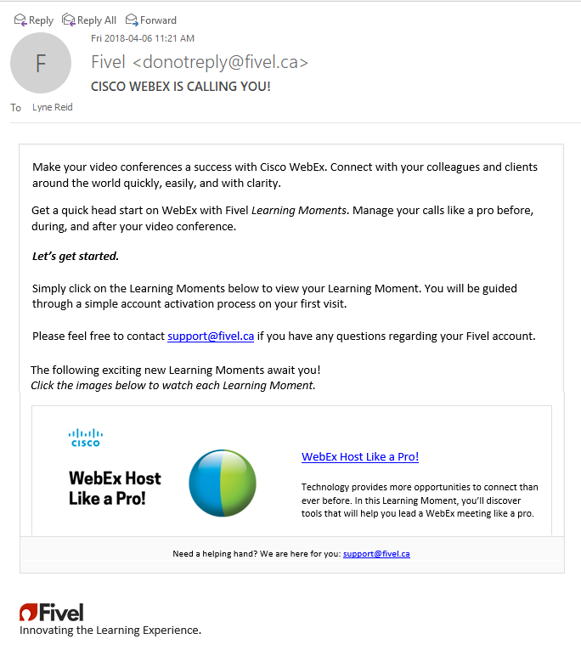
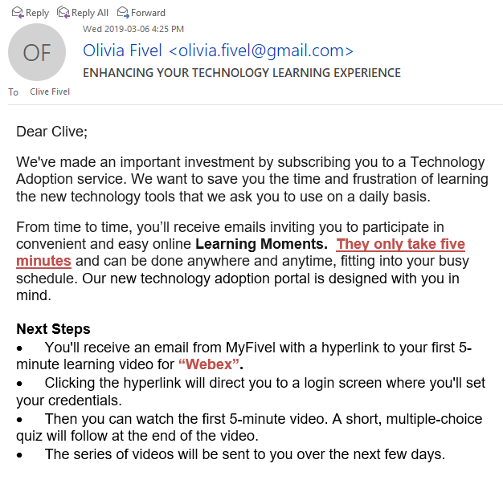
ADOPTION
PROGRAM
INTRO
ENHANCING YOUR TECHNOLOGY LEARNING EXPERIENCE

Slide 8
EXECUTIVE
ENDORSEMENT
VIDEO

Slide 9
LAUNCH LEARNING SERIES
Instructions
Clickable graphic link to access learning moments

Slide 10
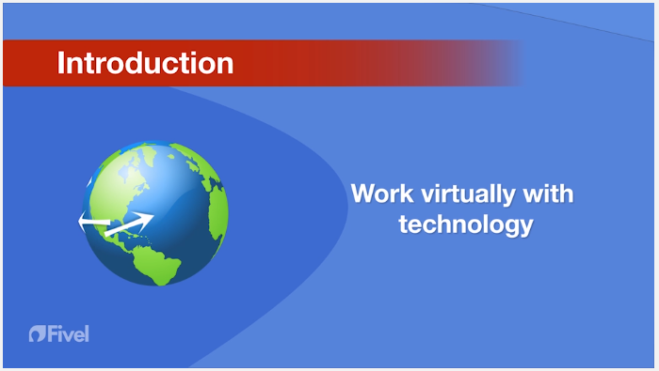
LEARNING MOMENT VIDEOS
Animation, graphics, images, symbols, any movement to keep the learner’s attention and enhance their ability to learn

Slide 11
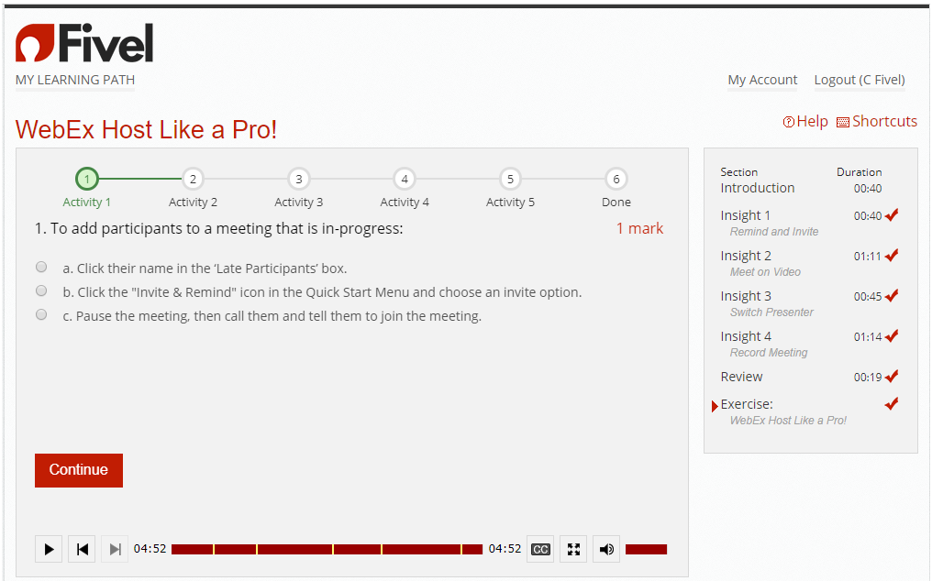
RETENTION PATH
Get the learner to recognize, and recall the main points from the module

Slide 12
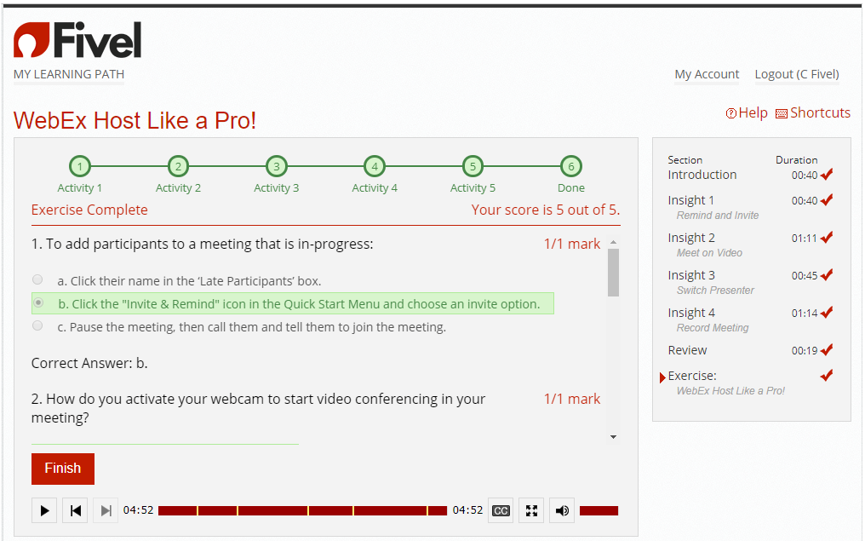
RETENTION PATH
Directly after completing the module
Multiple Choice or True/False question format

Slide 13
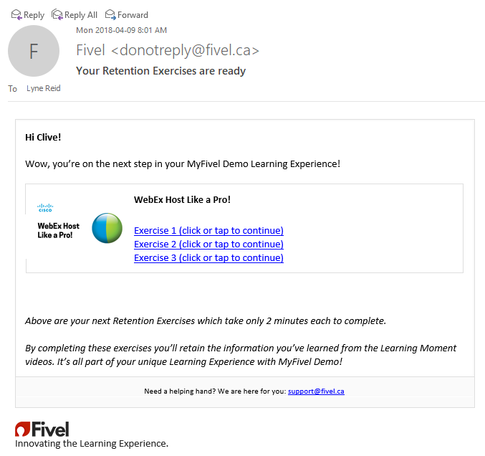
RETENTION PATH
Designed to activate long term memory
Repetition – each recall provides an additional access route to the memory
Spaced Retrieval – increases memory encoding

Slide 14
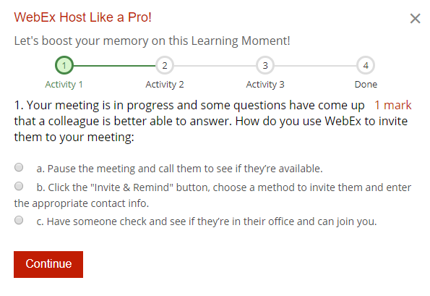
RETENTION PATH
Exercises issued over 2-4 week duration
To get the learner to apply the knowledge into a hypothetical, real life situation
Scenario-based Multiple Choice, True/False, and Matching questions

Slide 15
FIVEL ANALYTICS

Slide 16
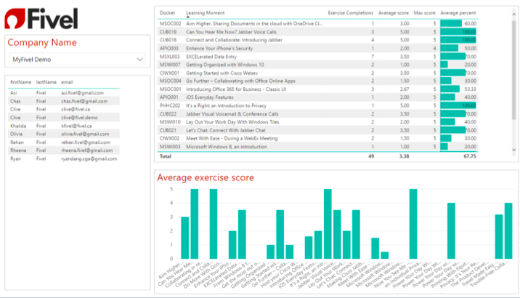
Detailed Report

Slide 17
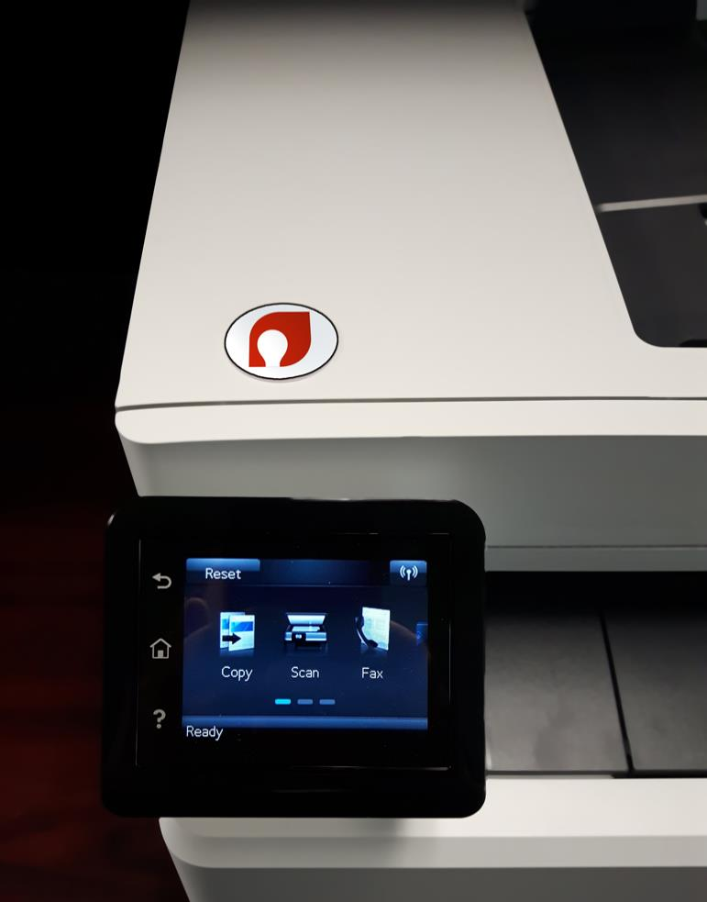
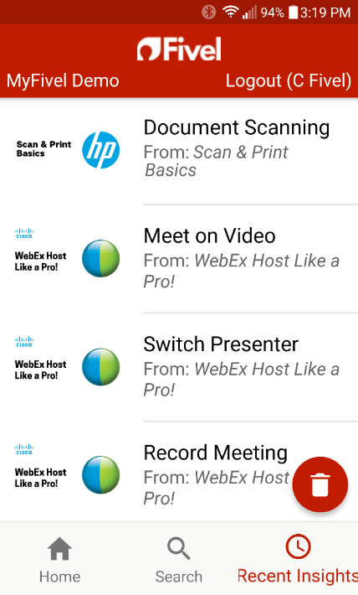
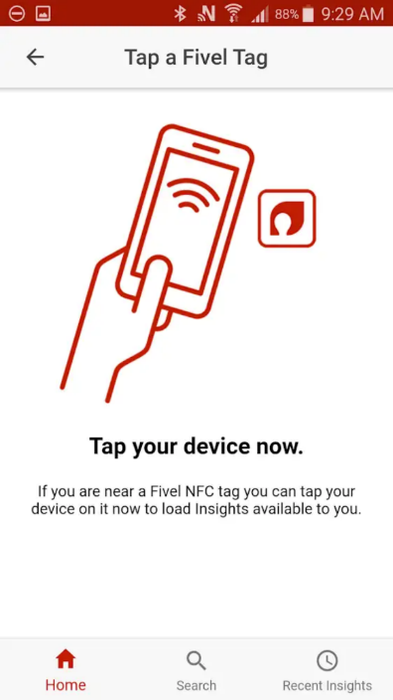
LOCATION
TAGS
Fivel’s GetIT app, beacons and NFC tags
Enable users to access specific insights on their mobile devices
Provides information to the user exactly when it’s needed

Slide 18
MOBILE
ACCESS
Accessible for a learner’s preference and time constraints
Scalable for all devices based on screen size, platform, and orientation

Slide 19
TRAINING
is an event.
USER ADOPTION
is an outcome.

